Slide 1
Shared Pain vs Split Pain

Slide 2
Systems Thinking

Slide 3
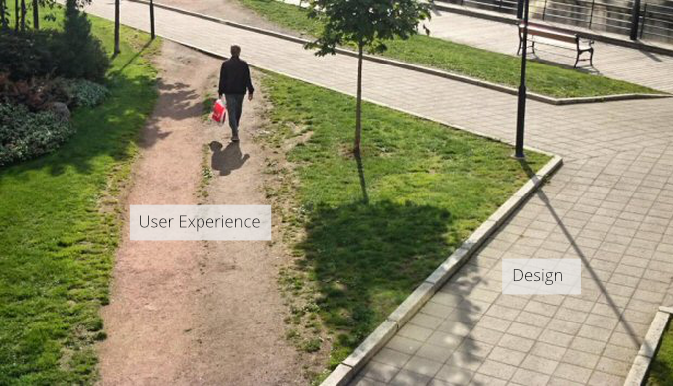

Slide 4

The Cobra Effect

Slide 5
Do the people who create systems
~~study~~
Systems thinking?

Slide 6
Shared Pain vs Split Pain

Slide 7


Slide 10


Locked

Slide 11

Story #1 - Devops

Slide 12
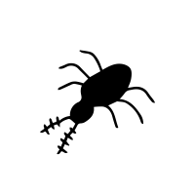

Dev
OPs

Slide 13
OPs
Dev
+

Slide 14
Dev
OPs

Slide 15
Dev
DevOPs

Slide 16

Story #2 Cost of build

Slide 17


Slide 18
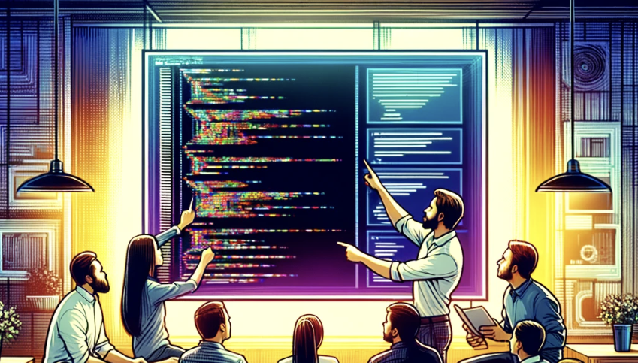

Slide 19

Story #3 – Working with a library

Slide 20
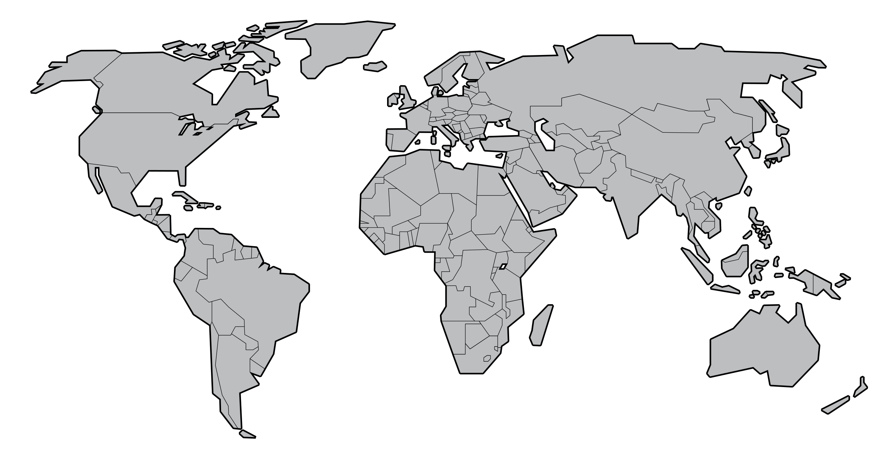

Slide 21


Client
Code
Chris

Slide 22
Client
Code
Chris
Unit Tests

Slide 23

Unit Tests
Chris

Slide 24
Unit Tests
Chris

Slide 25
Unit Tests
Chris

Slide 26

Story #4 – Works on My Machine

Slide 27
Story #2 – Works on My Machine

Slide 28


Testers
Dev

Slide 29

Story #5 – Testing Videos

Slide 30

Testers
Dev

Slide 31

Testers
Dev

Slide 32

Testers
443 (https)
Dev

Slide 33
Testers
443
Dev

Slide 35
Testers
443
Dev

Slide 36
There is currently a security bug bounty. If a security bug is found in production, a reward is paid to the hacker that finds it.
This bounty is paid from the budget of the team responsible for the project.
There has been over $1,000,000 in payouts.

Slide 37

Story #6 – Bug Bounty

Slide 38
There is currently a security bug bounty.
If a security bug is found in production, a reward is paid to the hacker that finds it.
This bounty is paid from the budget of the team responsible for the project.
So far, there has been over $1,000,000 in payouts.

Slide 39
Scenario: A team finds and fixes a security bug before a hacker has reported it.

Slide 40
Q: How long should they wait to release the fix?

Slide 41
Q: How many days should we give the hackers before we release the fix?

Slide 42
A: Usually no more than 2-3 days (Until the Release Management Process gives an OK )

Slide 43
Why?

Slide 44
Dev Team
Code Freeze Team
Penalized if Security Bugs are: * Discovered
* Derivate Bug found
* Bugs take long to fix
Penalized if:
Security Bugs are: * Discovered
* Derivate Bug found
* Bugs take long to fix * Release breaks anything
Best strategy:
Fix Fast and Release
Best strategy:
Be as conservative as possible

Slide 45
Dev Team
Code Freeze Team
Penalized if Security Bugs are: * Discovered
* Derivate Bug found
* Bugs take long to fix
Penalized if:
Security Bugs are: * Discovered
* Derivate Bug found
* Bugs take long to fix * Release breaks anything
Best strategy:
Fix Fast and Release
Best strategy:
Be as conservative as possible

Slide 46
Dev Team
Penalized if Security Bugs are: * Discovered
* Derivate Bug found
* Bugs take long to fix
Code Freeze Team
Penalized if:
Security Bugs are: * Discovered
* Derivate Bug found
* Bugs take long to fix * Release breaks anything
Best strategy:
Fix Fast and Release
Best strategy:
Be as conservative as possible

Slide 47
?
?
Company
?
Dev Team
?
?
Penalized if Security Bugs are: * Discovered
* Derivate Bug found
* Bugs take long to fix
Code Freeze Team
Penalized if:
Security Bugs are: * Discovered
* Derivate Bug found
* Bugs take long to fix * Release breaks anything
Best strategy:
Fix Fast and Release
Best strategy:
Be as conservative as possible

Slide 48


Messaging Engine Team
Team penalized if Security Bugs are: * Discovered
* More found
* Bugs take long to fix
Error connecting to database with user: tmobile and pw: helloWorld
Code Freeze Policy
48 to fix
Found, Fixed & tested with 1 hour
Management Penalized if: * Release breaks anything
Also found another endpoint with same vulnerability
Release to Production?
Best strategy: Fix and Release quickly
“Let’s wait…”
Best strategy: Do nothing

Slide 49
Do the people who create systems
~~study~~
Systems thinking?

Slide 53

Story #7 – Your Story

